Slide 1
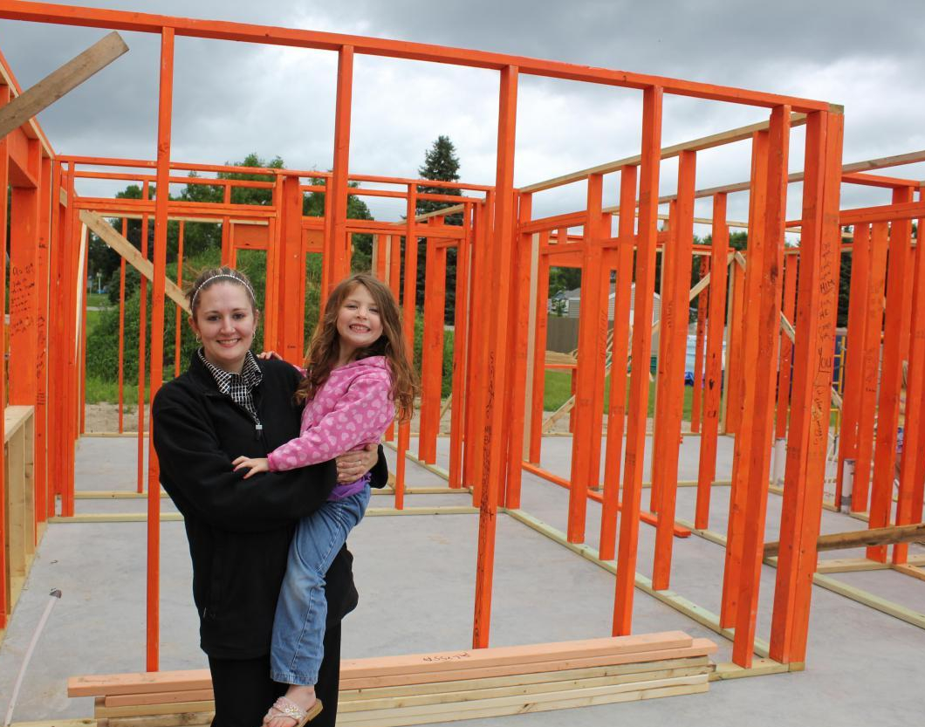
Impacts of Habitat for Humanity Homeownership
Connections to Quality of Life

Slide 2
About the study
Wilder Research conducted phone interviews of 402 homeowners from across Minnesota
Investigates connection between Habitat homeownership and quality of life.
Data analyzed by region (Northern, Southern, Twin Cities) and by length of residence
Safety
Health
Education
Social Connectedness
Family Interaction & Personal Well-Being
Economic Situation

Slide 3
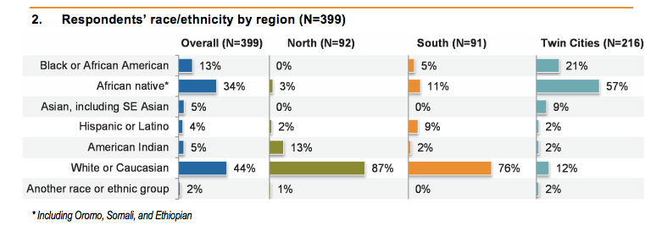
Homeowner characteristics
55% lived in Habitat home more than 5 years; 87% at least two years
98% have children
70% of respondents were female; in Twin Cities, just 58% vs. 83% in Greater MN

Slide 4
Overall, 92 percent of homeowners said their lives were better
Of those 92 percent who said their lives were better, 89 percent said they attributed that positive change either “completely” or “a lot” to Habitat.
“Habitat for Humanity - they make me happy because when you have little children and when they are young, they are jumping or running every day. When you rent, people complain. Now they jump and run and they are free. No one complains. They have a yard, a backyard. We’re feeling good, very good.”

Slide 5
Homeowners feel safe
Over 90% of homeowners feel safe in their homes
About 80% feel safer than they were in their previous homes and similar percentage feel that their children are now safer
Relatively similar across regions
“Before we were living in a drug infested neighborhood in a tiny little house that had been made into a duplex. We had lead paint, no furnace filter; there was a hole in the furnace which would leak. I had to tape over the hole so we didn't have to breathe in the fumes. So having this [Habitat] home makes a huge difference of not having to live in that environment.”

Slide 6
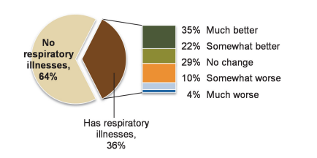
Homeowners report improvements in respiratory conditions
Of homeowners who have a family member with respiratory illnesses, 57 percent said they improved after moving into their Habitat home.
Of those with respiratory illnesses, 74 percent of shorter-term homeowners noted an improvement to their condition, whereas 47 percent of longer-term homeowners noted improvement. The improvement with shorter-term homeowners aligns with the implementation of the Healthy Homes program, and more research should be done to explore this connection.

Slide 7
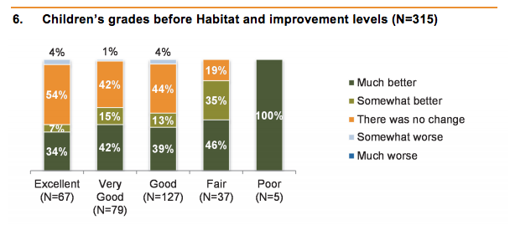
Habitat has positive influence on children’s education
Over half of homeowners said their children’s grades improved after moving into their Habitat home. Impact is more significant for those who were struggling most in previous housing situation.
About two-thirds of the homeowners feel more confident about their ability to fund their children’s college education.
Overall, 90 percent of homeowners said they feel better about their children’s future.

Slide 8
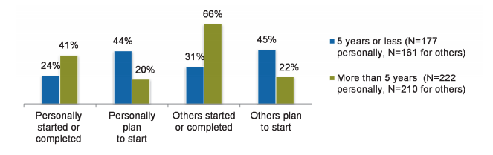
Habitat has positive influence on adult education too
In 92 percent of the Habitat homes, at least one adult started, completed, or plans to start higher education or training programs after moving in.

Slide 9
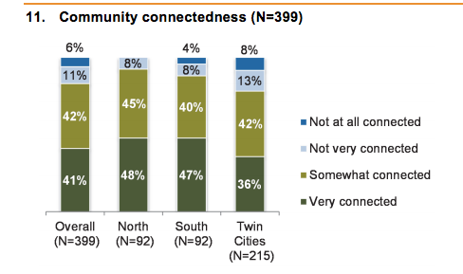
Homeowners feel connected
More than 80 percent of homeowners reported they feel connected to their community, and over half said they participate more in community activities.
Two-thirds of families said their children spend more time with their friends and classmates.

Slide 10
Homeownership affects self-esteem & families
Two-thirds of homeowners said they get along better with their families, and 70 percent spend more time with their families.
Nearly 90 percent of homeowners said they feel at least “somewhat better” about themselves, and 75 percent of homeowners feel “much better” about themselves, compared to before becoming a Habitat homeowner.
“We get along a lot better. Before we lived in a very cramped place, we fought a lot more - my two sons were not friends at all - now they are best friends. My daughter and I did not have a relationship but since the Habitat house, my daughter and I are very close.”

Slide 11
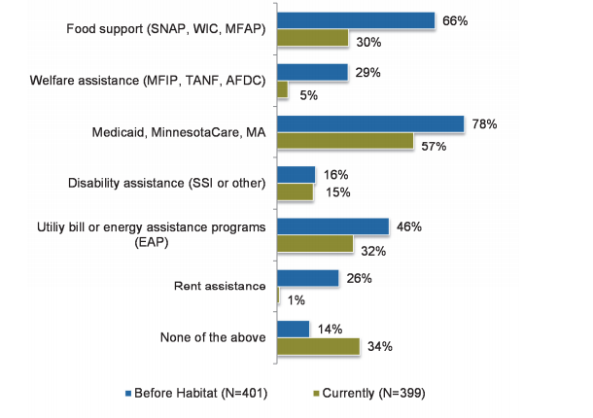
More than 50% have more money and pay less for housing
Over half of homeowners said they have more money since moving into their Habitat home, and almost 40 percent said they pay less in housing costs.
In nearly half of Habitat households, someone changed jobs since becoming a homeowner. Of those, 80 percent said their jobs are better.

Slide 12
Decreased use of government assistance
Overall, 87 percent of homeowners used some form of government assistance at the time of application, and, at the time of the interview, that percentage declined by 20 points.
Use of every type of government assistance program except for disability declined by at least 15 percentage points.
Cost-benefit analysis - 2,200 Habitat homeowners save Minnesota $6.4 to $9.3 million government assistance programs annually.

Slide 13


